Slide 1

Ad Grants Online Marketing Challenge
Pre-campaign Report
Partnered with FreeGeektwincities.org
Presented by- Group 13

Slide 2
NON-PROFIT PARTNER OVERVIEW
Org. Name - FreeGeekTwinCities
Website - FreeGeekTwinCities.org
Cause - Recycle and Reusing eWaste
Location - Minneapolis, MN
Org. Size - Medium Sized Non-Profit
Products and services - Computer Equipment and peripherals, Consumer and commercial electronics
Mission - Free Geek Twin Cities (FGTC) is dedicated to addressing the following issues though direct, local, community-driven action:
The Digital Divide
Electronic Waste (eWaste)

Slide 3
NON-PROFIT PARTNER OVERVIEW
Org. Name - FreeGeekTwinCities
Website - FreeGeekTwinCities.org
Cause - Recycle and Reusing eWaste
Location - Minneapolis, MN
Org. Size - Medium Sized Non-Profit
Products and services - Computer Equipment and peripherals, Consumer and commercial electronics
Mission - Free Geek Twin Cities (FGTC) is dedicated to addressing the following issues though direct, local, community-driven action:
The Digital Divide
Electronic Waste (eWaste)

Slide 4
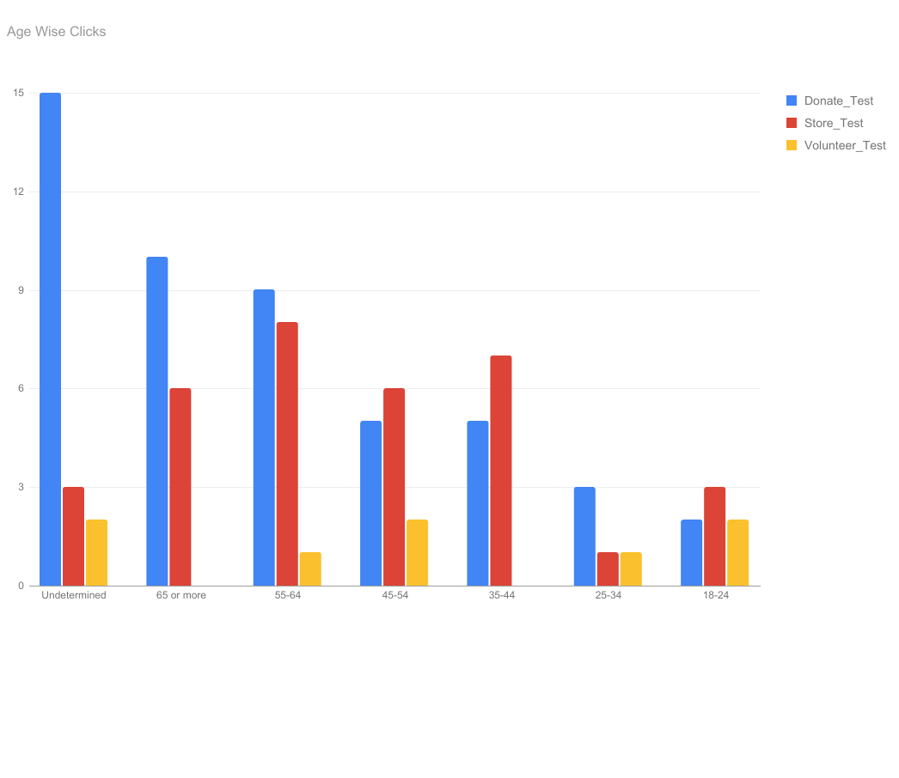
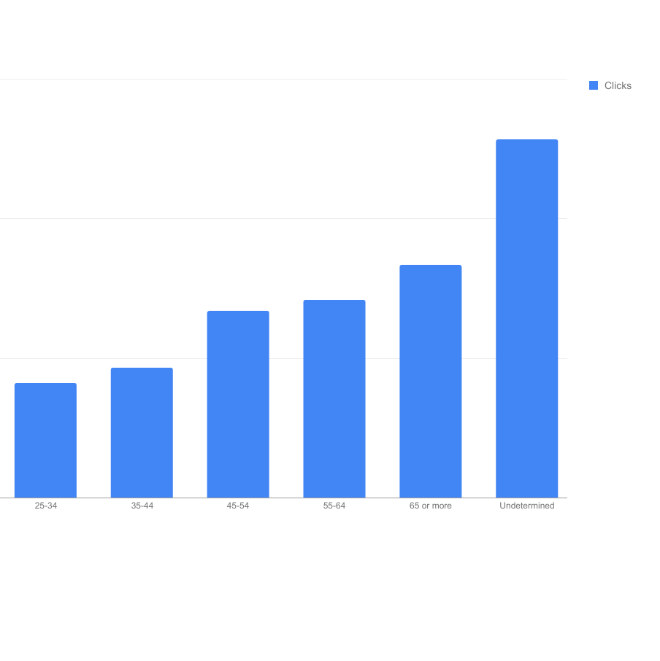
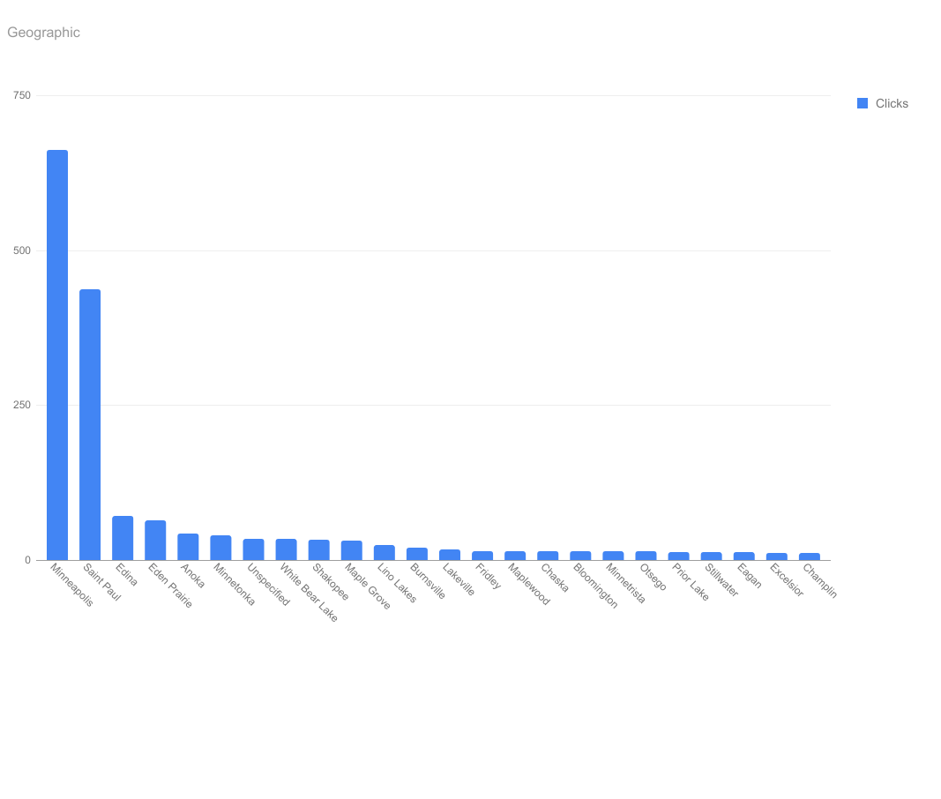
Market and Target Audience Analysis
The fees for monitors and TVs with CRT/Tube, projection TVs (no fees on undamaged LCD/LED/Plasma monitors or TVs):
<20″ $15
21″-25″ $25
26″-40″ $50
>40″ $75
Bare tube, broken CRT, or damaged plasma screens $15

Slide 5
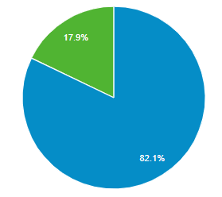
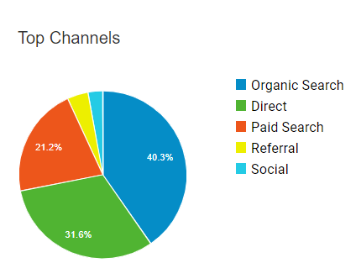
CURRENT MARKETING
Social Network Facebook
Youtube
Current Online Marketing
Three Google Adwords Campaign with total six ad groups.
Facebook page
YouTube
Current Marketing budget - $329/month from Google
Current Marketing Goal – CTA, Website Visits, Store Visits and Volunteer hired
Website overview
Descriptive Website with detailed overview of the mission
Easy access to contact through Call to Action buttons
Homepage is very static which makes the visitor scroll more than interacting with the website.
Improvement needed in make landing pages more visual

Slide 6
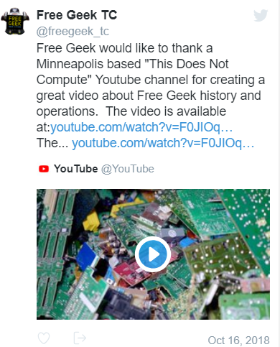
MARKETING GOALS
There are still many people in our community that do not have access to computers and the Internet, or do not possess the skills to adequately leverage these technologies
Volunteers work in programs where they gain skills on how to use, build, and understand computers
Approximately 500 volunteers per year to attract more volunteers run ads specific for free IT training(A+ and M+ certification students)
Seasonal events run throughout the year city level promotional events with the goal to increase donations and volunteers.
Use of Adwords has not been implemented yet for the promotional events. Target specific campaigns will boost donations.
FGTC accepts electronic waste and its first goal is to reuse this material and refurbish it into a new computer to give to volunteers or to sell in our thrift store
Seasonal events run throughout the year.City level promotional events with the goal to increase donations and volunteers. Use of Adwords has not been implemented yet for the promotional events. Target specific campaigns will boost donations

Slide 7
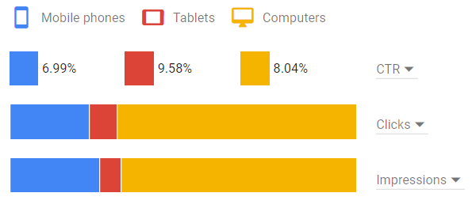
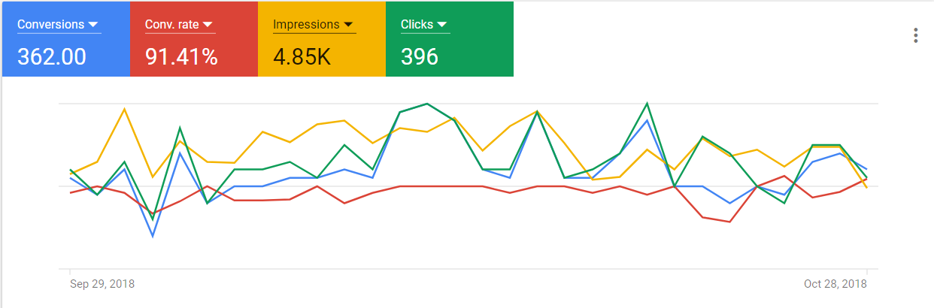
ACCOUNT PERFORMANCE
Impressions
Desktop - 67.6%
Mobile & Tablets - 32.5%
Clicks
Desktop - 69.1%
Mobile & Tablets - 30.9%
Click through to the landing page/Rate
CTR% Desktop - 8.04%
CTR% Mobile & Tablet - 16.57%
Conversions/Conversion Rates
In past 30 days, there were 362 conversions and
Conversion Rate is 91.41%

Slide 8
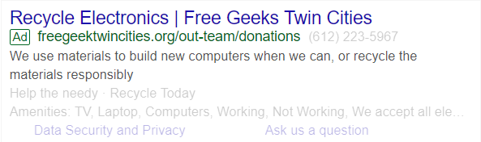
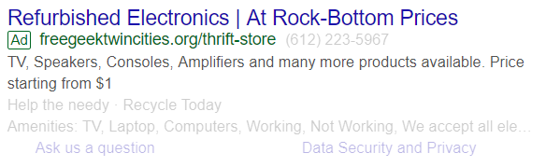
PROPOSED ADWORDS STRATEGIES
3 new campaigns and 5 strategies to implement
Google Keyword Planner- based on the different campaign we will use the google keyword planner run adwords campaign based on the right keywords
The Keyword Planner and Google Trends may be useful for keyword suggestions and traffic estimates. [Exact] and +modified +broad +match keywords are the planned match types for all Campaigns
Creating ad specific keywords to an adgroup- Combining ads with the landing pages that covers the same topics as the key words in an adgroup
DONATE | STORE | VOLUNTEER
Donate Computer Ad Group [recycling computer] [computer donation mn] [free trash dump] | Computer Ad Group [buy cheap computers] [cheap pc parts] [cheap computer repairs] +used pc | Community Help Ad Group [group volunteer opportunities mn] [group volunteer tie mn] [group volunteer twin cities]
Donate Electronic Ad Group [free tv recycling] [freegeek recycling] [recycle electronic near me] | Laptop Ad Group +used laptops + rent laptop | General Volunteer Ad Group +volunteer position+voluntary work
 | Other Electronics [microcenter refurbished] [amplifier repair shop near me] [cheap electronic store near me] [buy used electronic]

Slide 9
PROPOSED ADWORDS STRATEGIES
3 new campaigns and 5 strategies to implement
Google Keyword Planner- based on the different campaign we will use the google keyword planner run adwords campaign based on the right keywords
The Keyword Planner and Google Trends may be useful for keyword suggestions and traffic estimates. [Exact] and +modified +broad +match keywords are the planned match types for all Campaigns
Creating ad specific keywords to an adgroup- Combining ads with the landing pages that covers the same topics as the key words in an adgroup
DONATE | STORE | VOLUNTEER
Donate Computer Ad Group [recycling computer] [computer donation mn] [free trash dump] | Computer Ad Group [buy cheap computers] [cheap pc parts] [cheap computer repairs] +used pc | Community Help Ad Group [group volunteer opportunities mn] [group volunteer tie mn] [group volunteer twin cities]
Donate Electronic Ad Group [free tv recycling] [freegeek recycling] [recycle electronic near me] | Laptop Ad Group +used laptops + rent laptop | General Volunteer Ad Group +volunteer position+voluntary work
 | Other Electronics [microcenter refurbished] [amplifier repair shop near me] [cheap electronic store near me] [buy used electronic]

Slide 10
PROPOSED ADWORDS STRATEGIES
Our daily budget across campaigns is $329 (all campaigns combined)
Note :- This is the result from June 2018 to October 2018 ie for approximately about 5 months
Campaigns | Donate | Store | Volunteer
Budget | $200/day | $100/day | $29/day
Impressions | 7.06k | 6.15k | 1.3k
Clicks | 708 | 499 | 25
Conversions | 634 | 429 | 15

Slide 11
CORE PERFORMANCE METRICS TO TRACK
Goal | Mertrics | HOW
Increase Website Traffics | Cost Per Click ( Manual ) | CPC keyword bidding is a promising strategy for driving potential customer to Website
Conversion Tracking | CTR ( Click Through Rate ) | By increasing the number of impression that are their currently. If the impression increases there are more chances of increasing CTR. And can be done by keyword planning and Keyword bidding adjustment
Secondary KPIs are
Page Views
Landing Pages
And with the help of Google Analytics, volunteer campaign can we measured by the number of returning users and the website activity under the volunteer landing page

Slide 12
WEEKLY PLANS SUMMARY
Week 1
Create the new campaign with the same goals that were there for previously running campaign
Week 2
Optimize the keywords that do not have any impression
Week 3
Using Ad Extension for location, Callout Extension and Call Extension to the displaying ads
Week 4
Using the same keyword that were used previously by the non-profit
Add negative keyword to the ad groups and manual CPC
Comparing the previous running campaigns and adding the keywords that were not used in the new campaign and have preformed well previously
Add more ads for the campaigns ad groups from the previous campaigns those who have preformed well

